Slide 1


Where are they?
Departamento de Educación Parvularia
Colegio Madres Dominicas Concepción
Kínder B
Miss Francisca Almarza
May, 2020

Slide 2
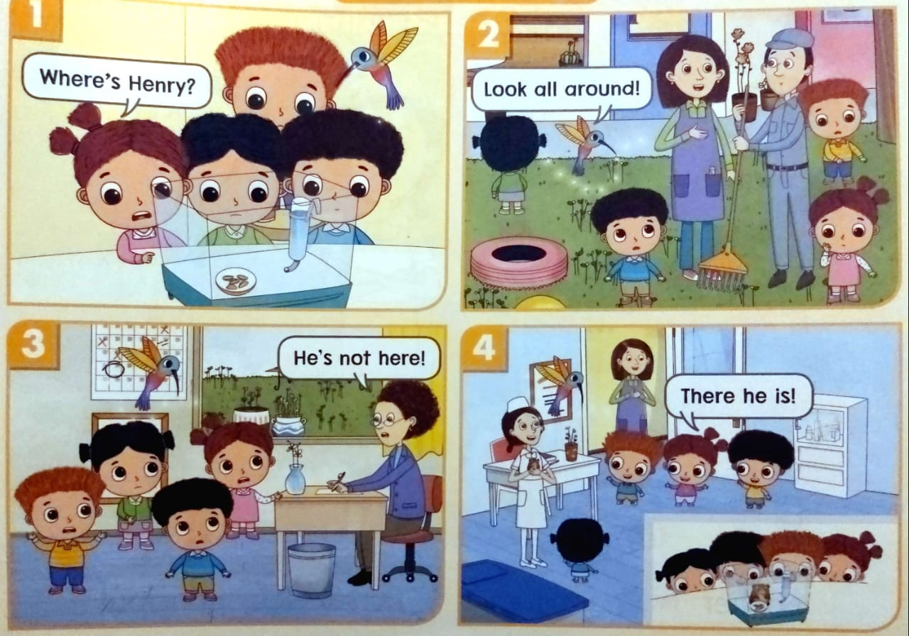
Where are they?
Click on the correct answer to go to the next page
The classroom
The nurse’s office

Slide 3
Where are they?
Click on the correct answer to go to the next page
The principal’s office
The playground

Slide 4
Where are they?
Click on the correct answer to go to the next page
The principal’s office
The classroom

Slide 5
Where are they?
Click on the correct answer to go to the next page
The playground
The nurse’s office

Slide 6
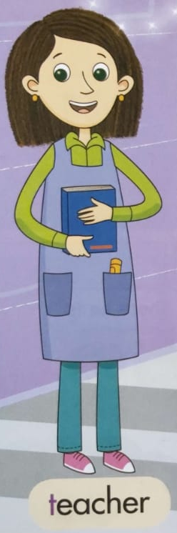

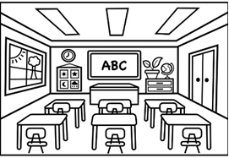
Listen and repeat
She is the teacher. She works in the classroom.

Slide 7

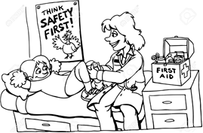
Listen and repeat
She is the nurse. She works in the nurse’s office.

Slide 8
Listen and repeat
She is the principal. She works in the principal’s office.

Slide 9


Listen and repeat
He is the Janitor. He works in the school.

Slide 10


Have a nice day🤗
Thank you!

