Slide 1


In the morning, in the evening
Departamento de Educación Parvularia
Colegio Madres Dominicas Concepción
Kinder B
Miss Francisca Almarza
May, 2020

Slide 2
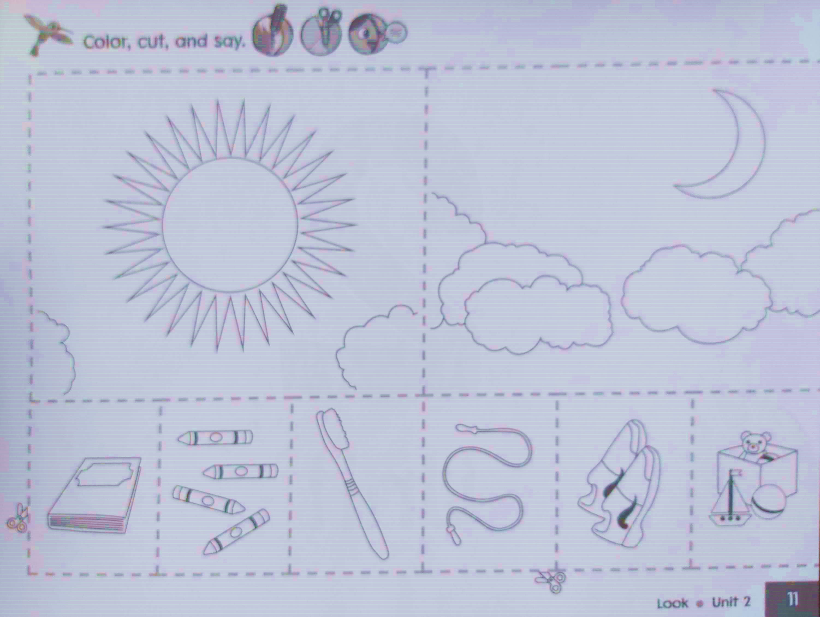

The morning, the evening

Slide 3
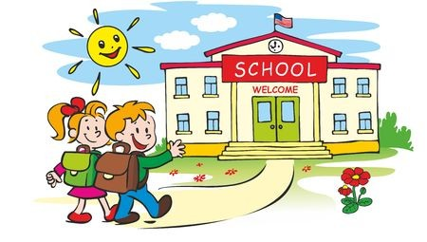
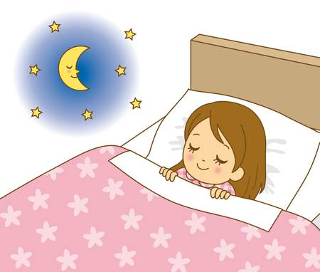
What do we do in…?

Slide 4
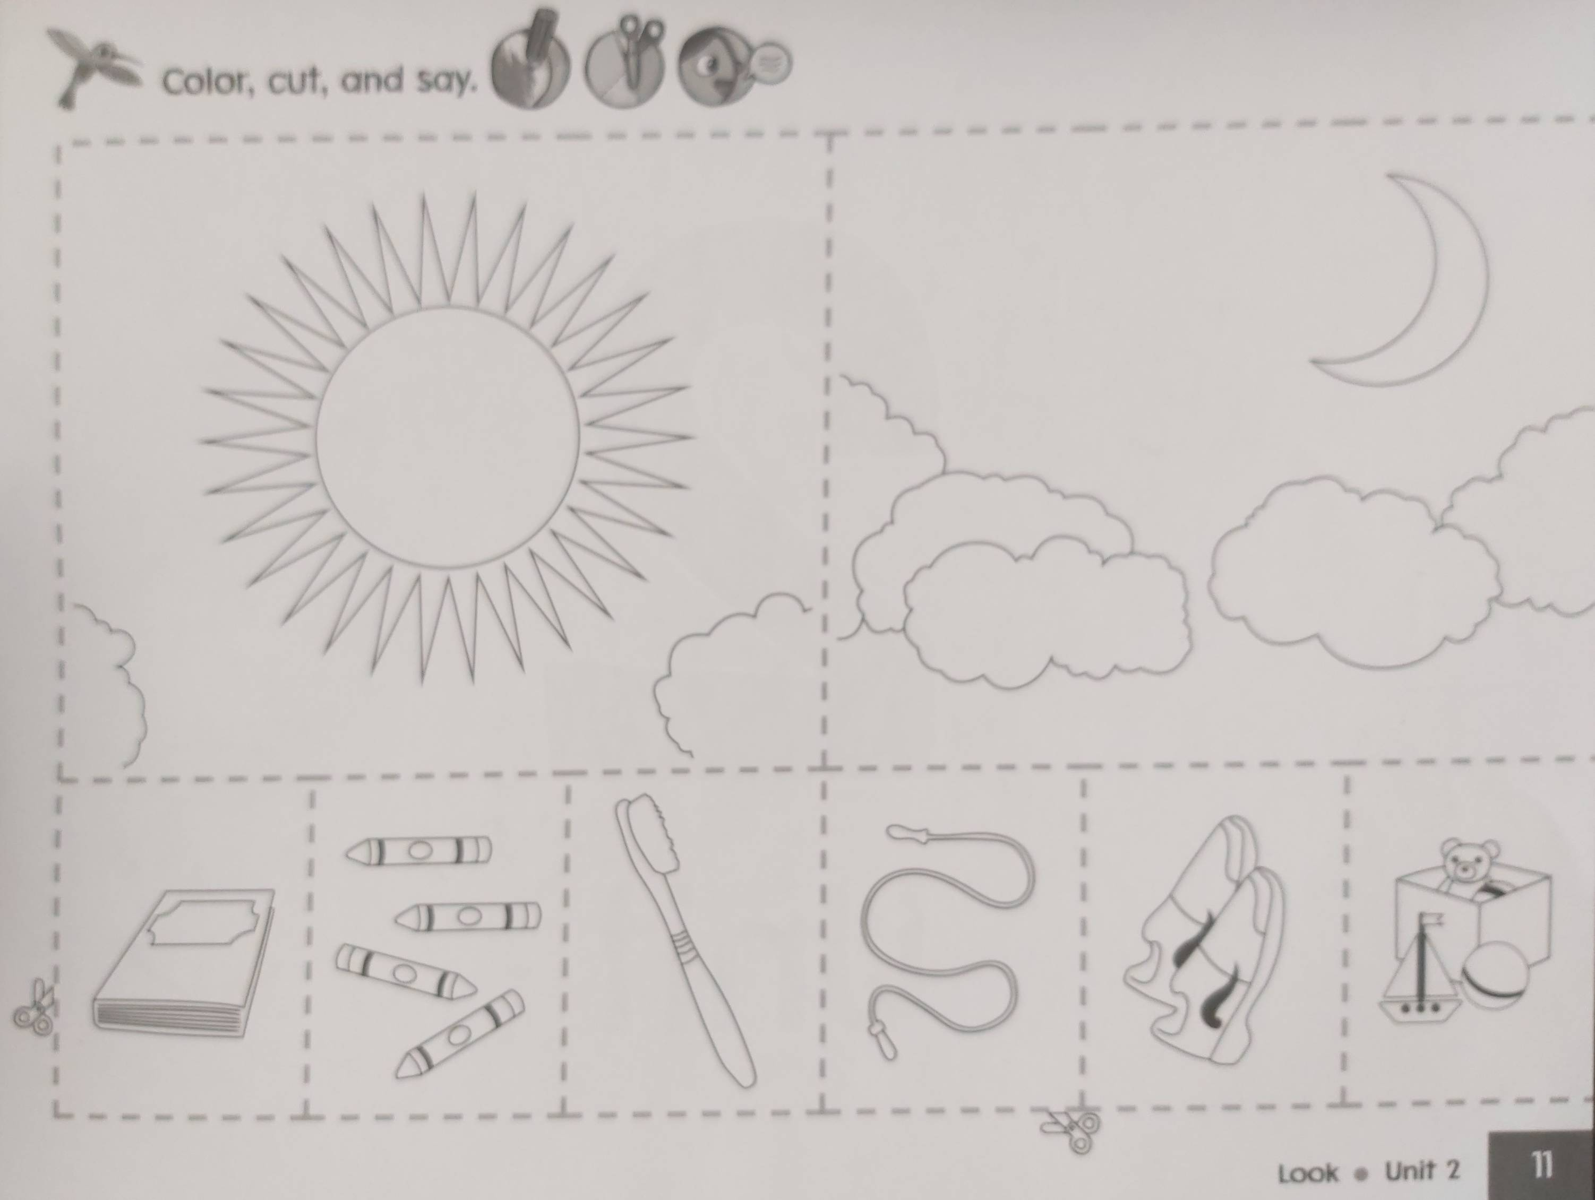
What do we use to…?

Slide 5

Read
Repeat after me
To

Slide 6
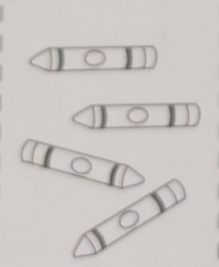
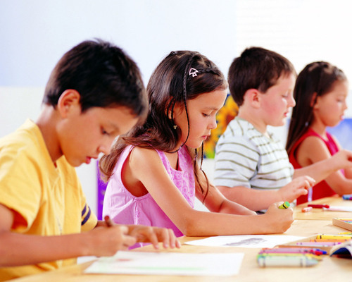
Draw
Repeat after me
To

Slide 7
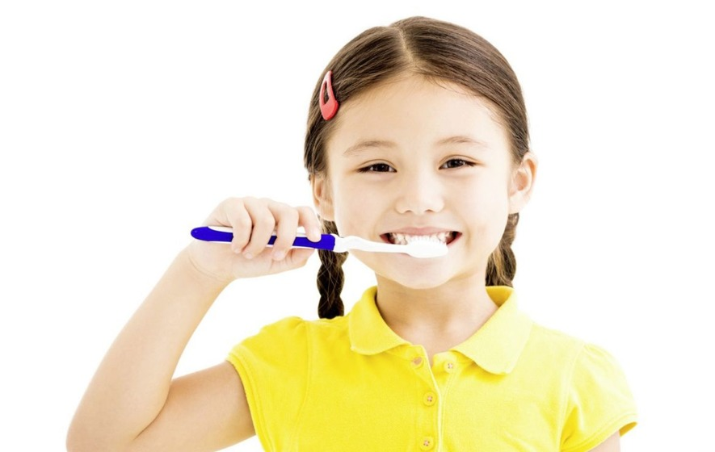
Brush my teeth
Repeat after me
To

Slide 8
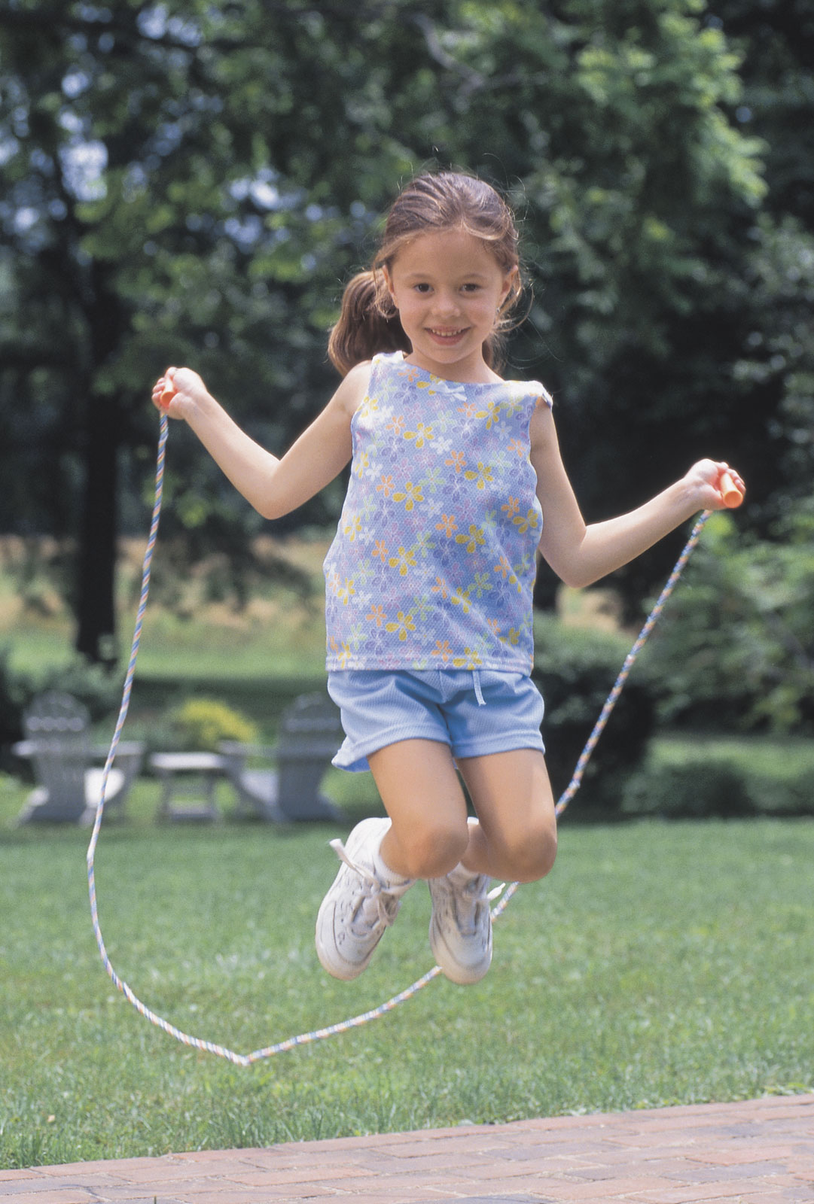
Jump the rope
Repeat after me
To

Slide 9
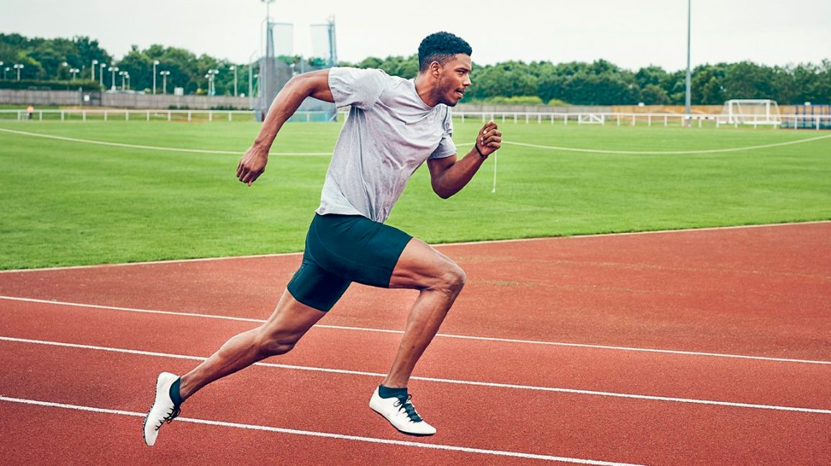
Run
Repeat after me
To

Slide 10
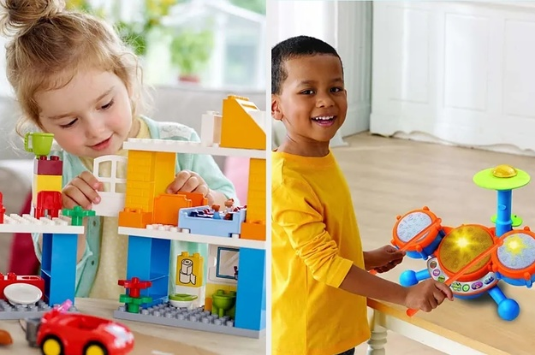
Play
Repeat after me
To

Slide 11
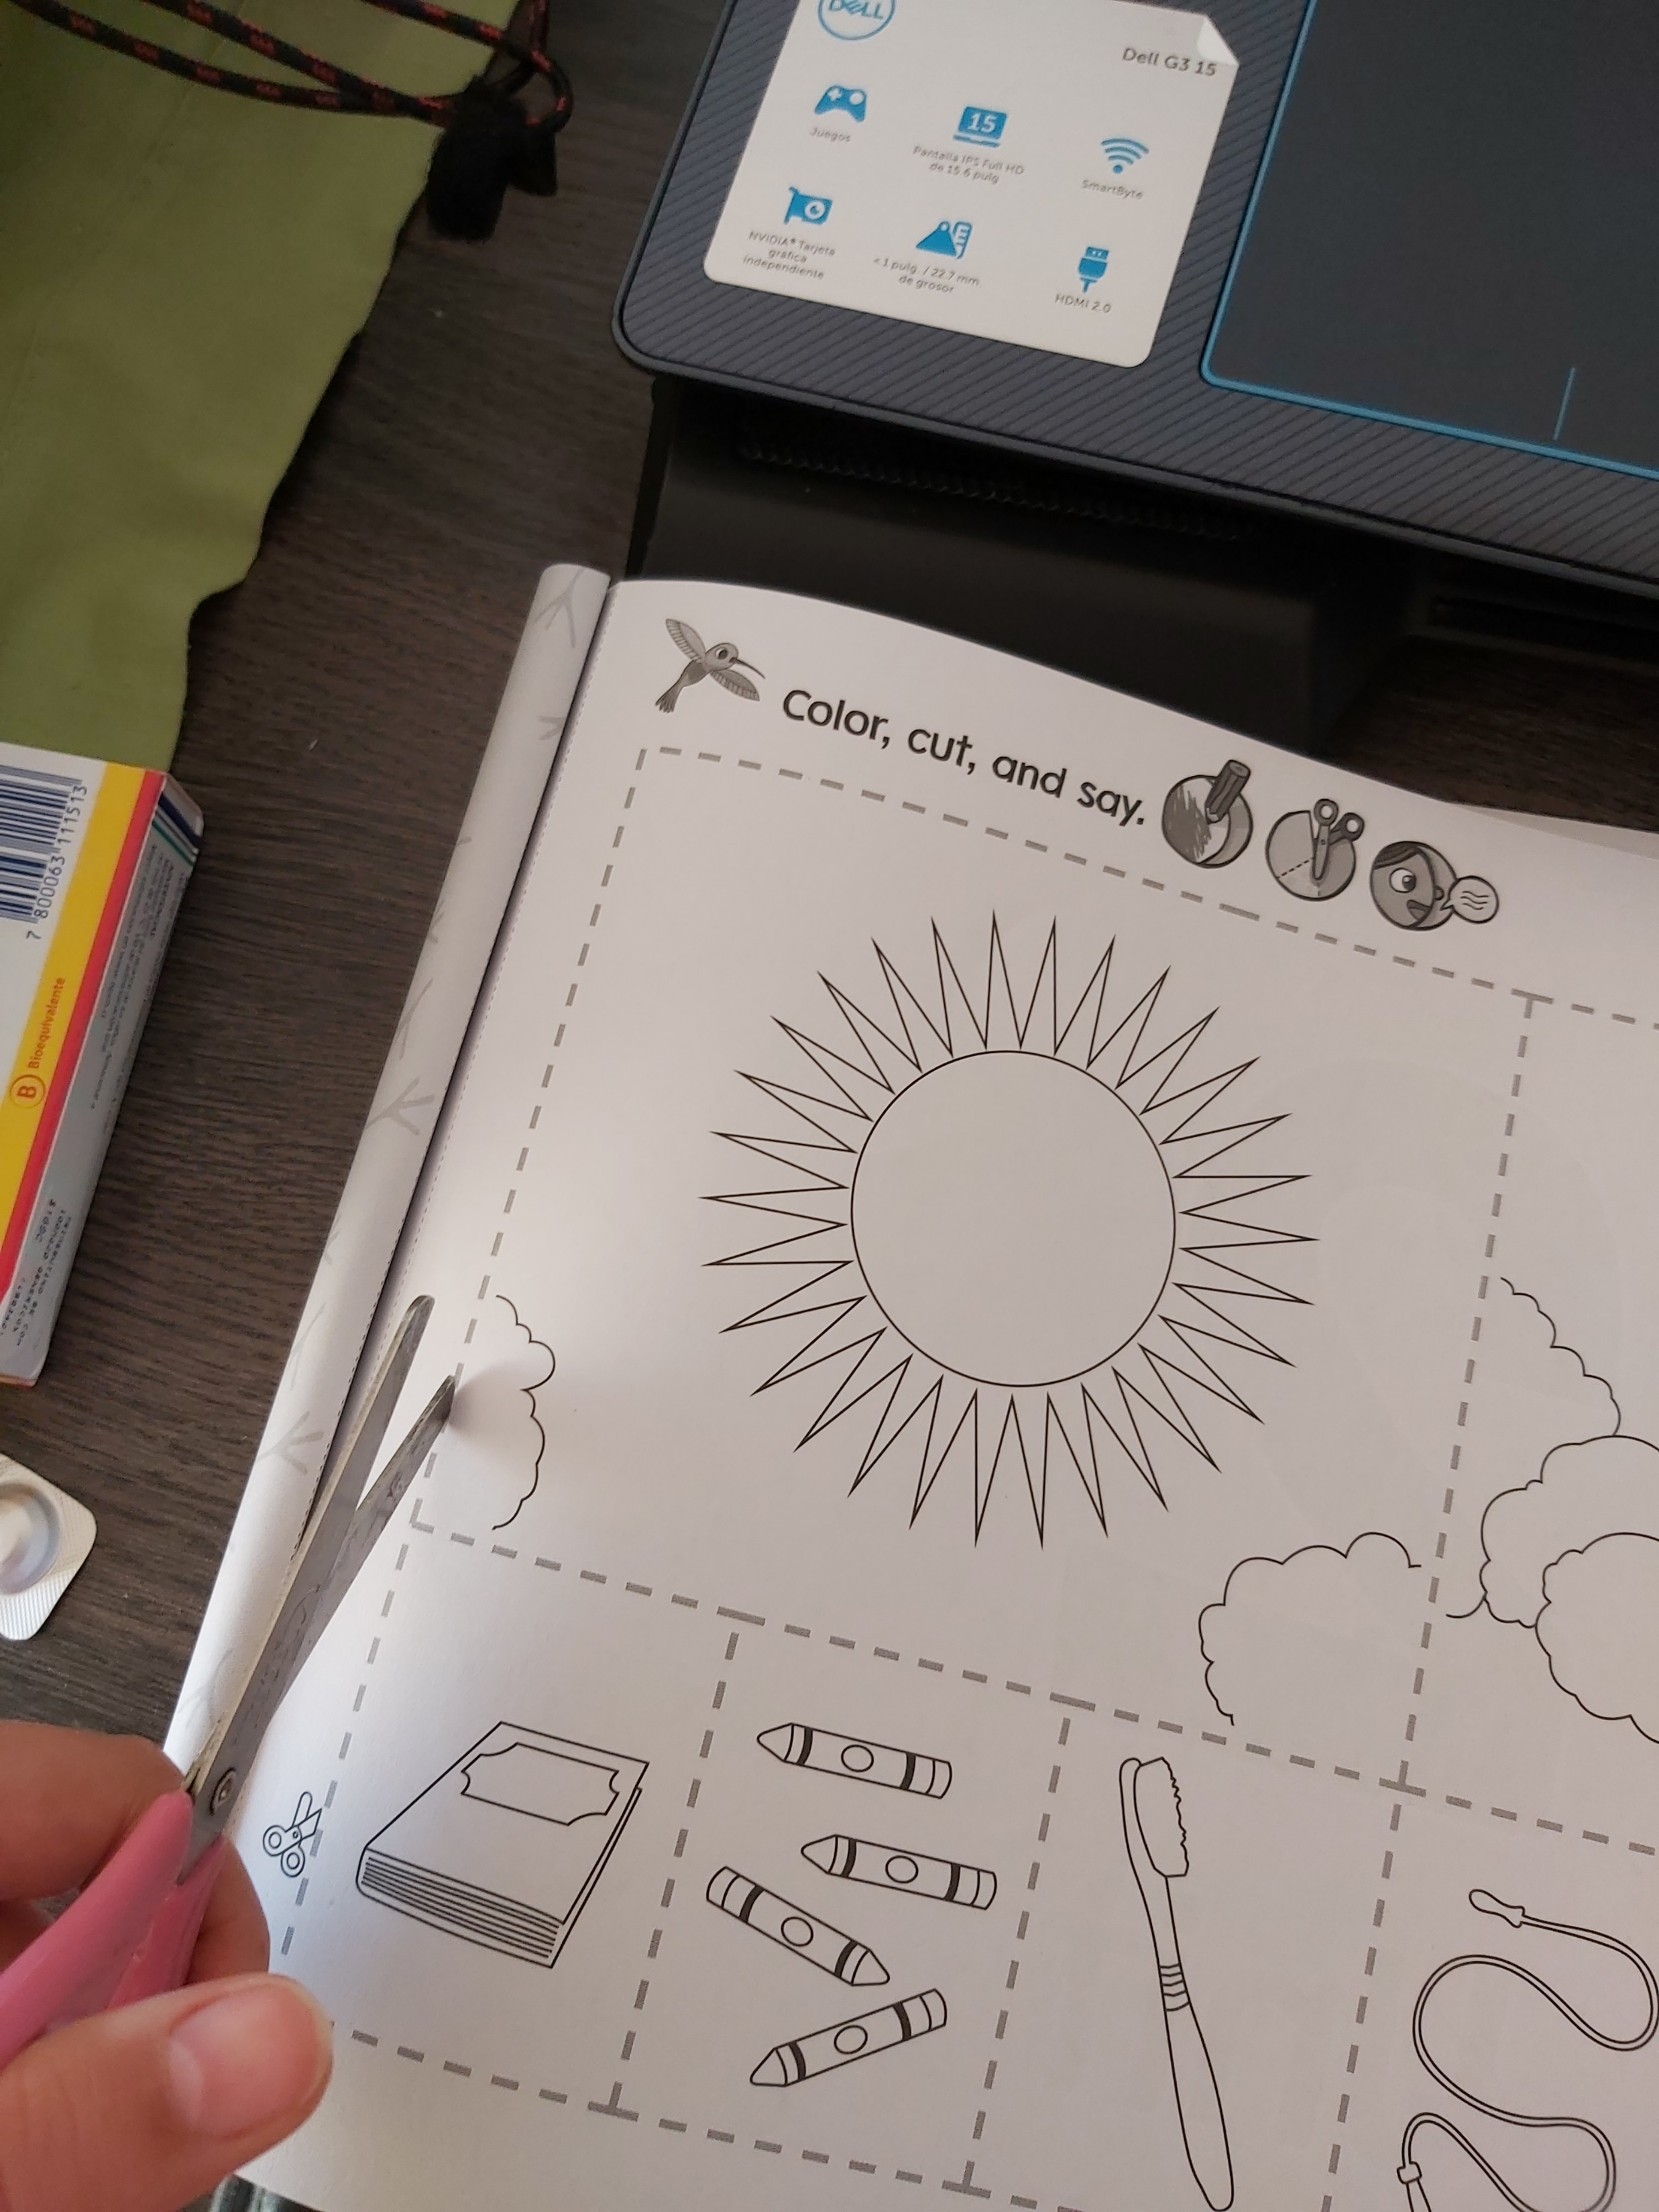
Cut and put together
Cut the cards
Put together what you do in the morning and in the evening

Slide 12

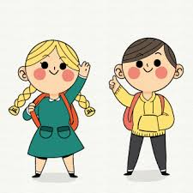
Have a nice day🤗
Thank you!

