Slide 1


Vocabulary: Places in town
Departamento de Educación Parvularia
Colegio Madres Dominicas Concepción
Miss Francisca Almarza
Kinder B
July, 2020

Slide 2

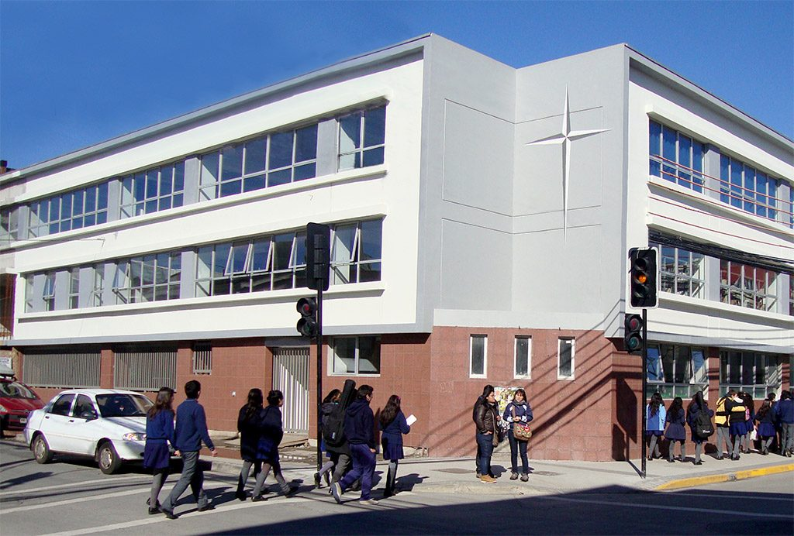
School

Slide 3
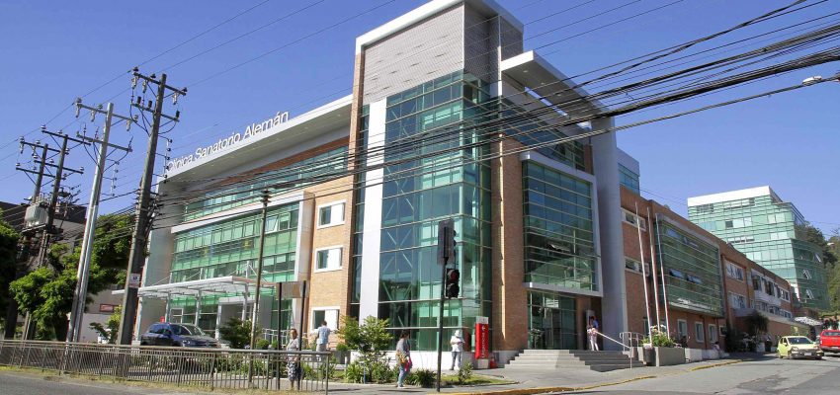
Hospital

Slide 4
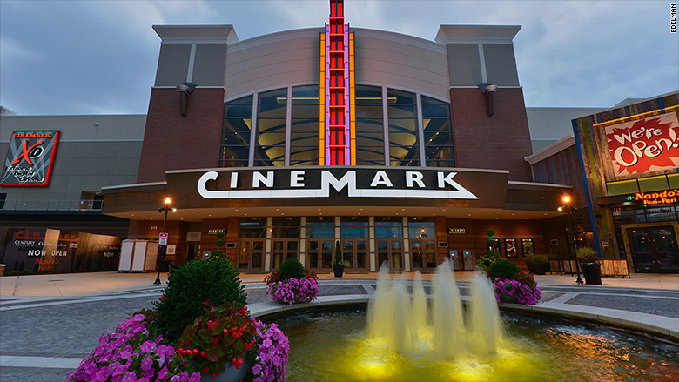
Cinema/Movie Theater

Slide 5
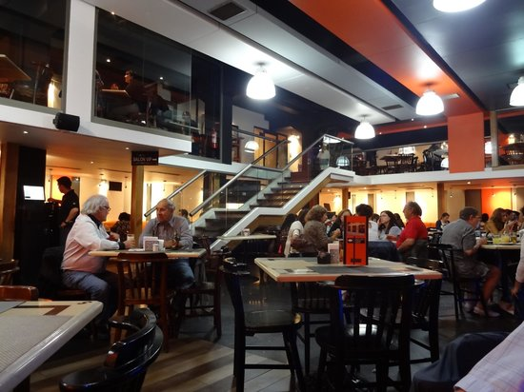
Restaurant

Slide 6
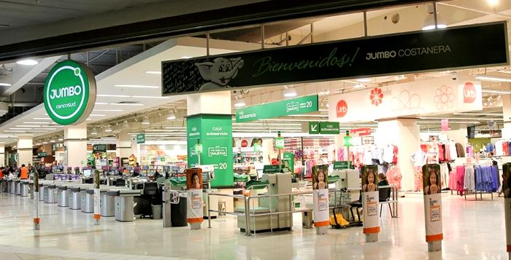
Supermarket

Slide 7
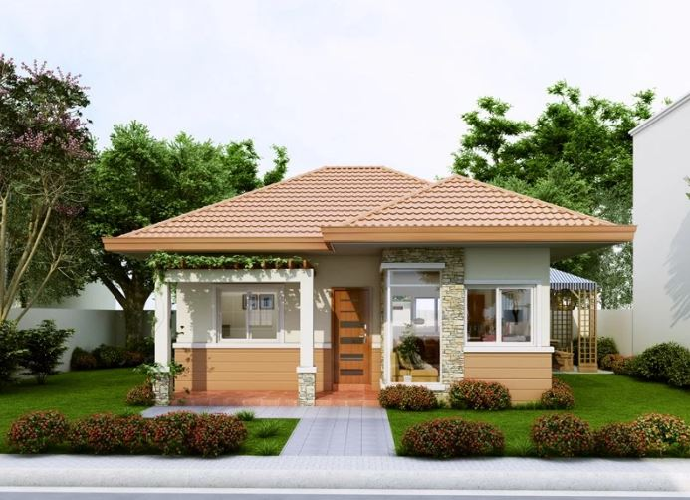
House

Slide 8
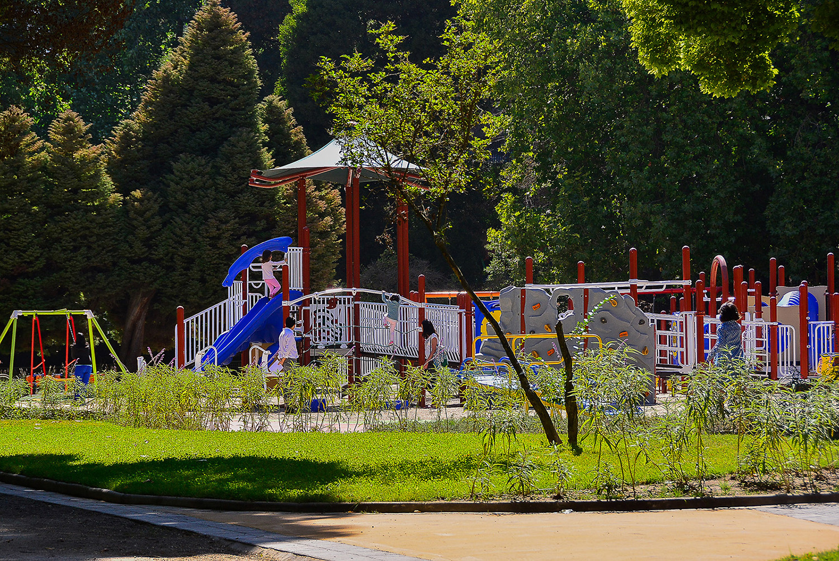
Park

