Slide 1


Signs around me
Departamento de Educación Parvularia
Colegio Madres Dominicas Concepción
22.06 – 26.06
Kinder B
Miss Francisca Almarza B.

Slide 2
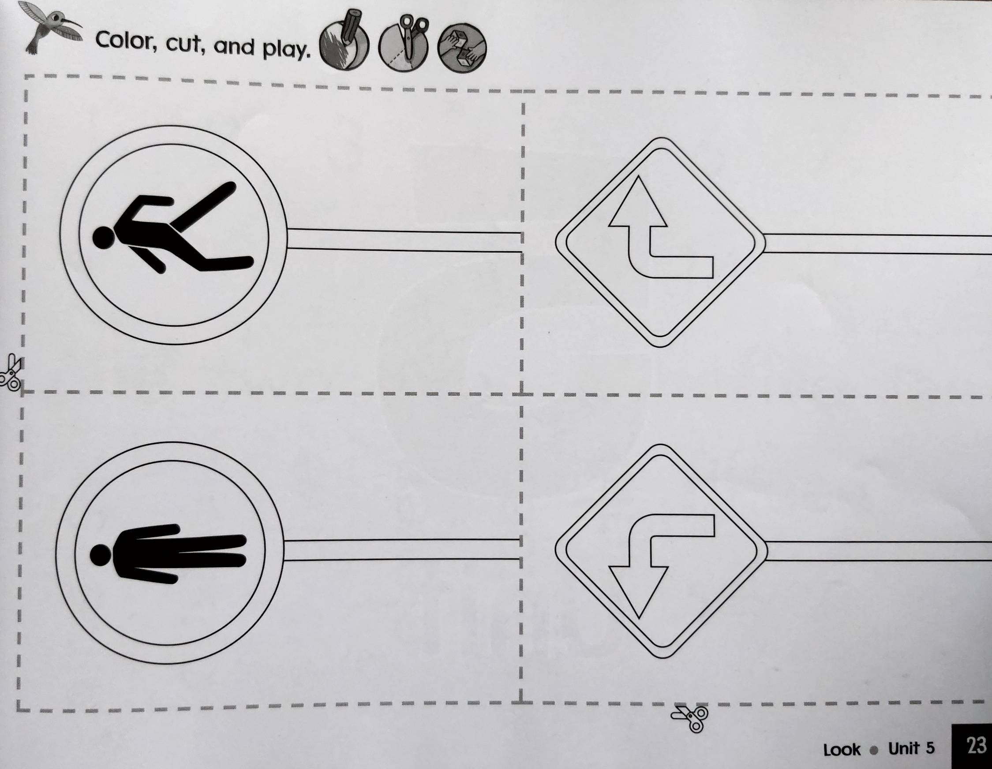

Activity Pad p.23

Slide 3
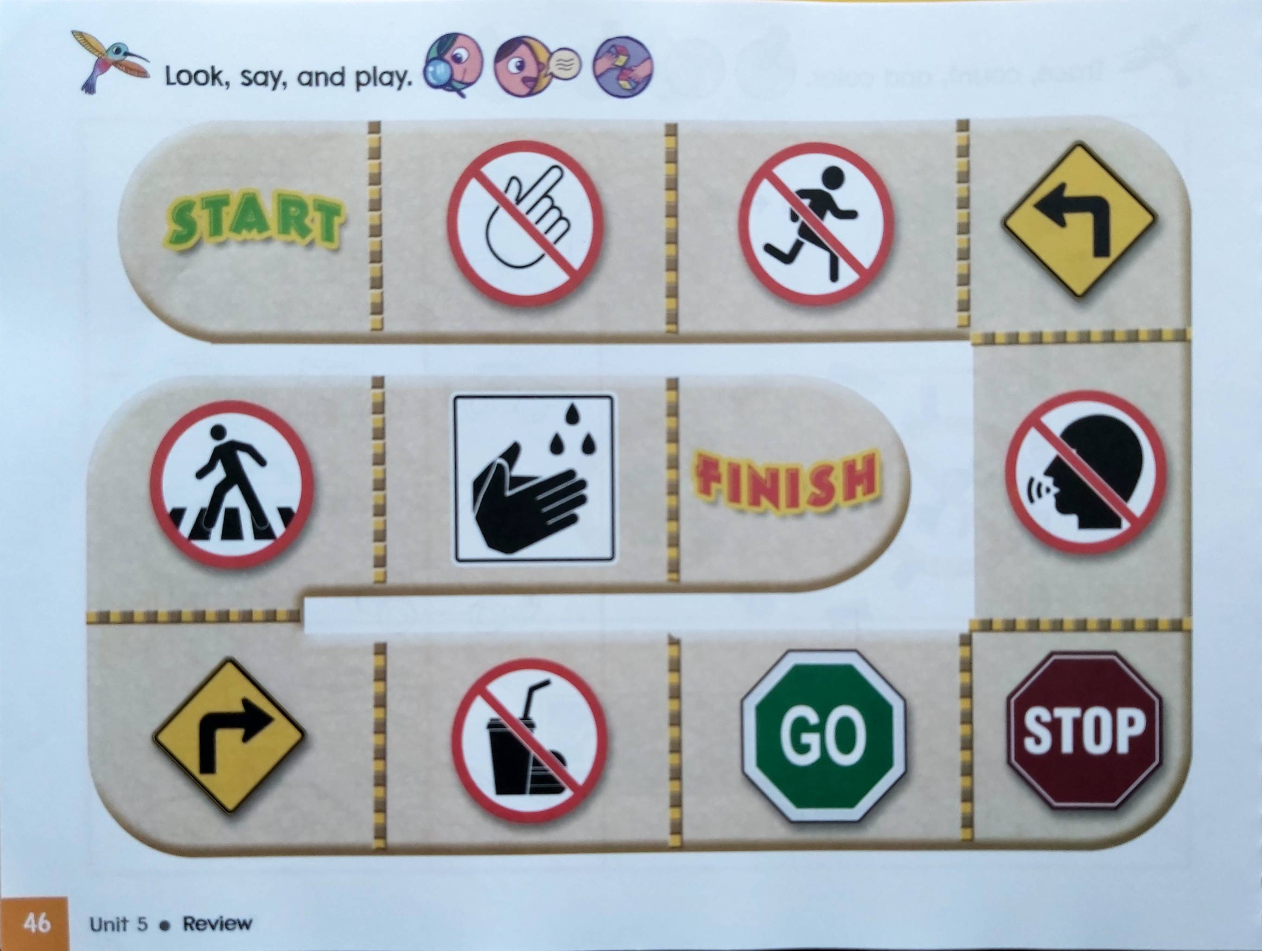
Student’s Book p. 46

Slide 4
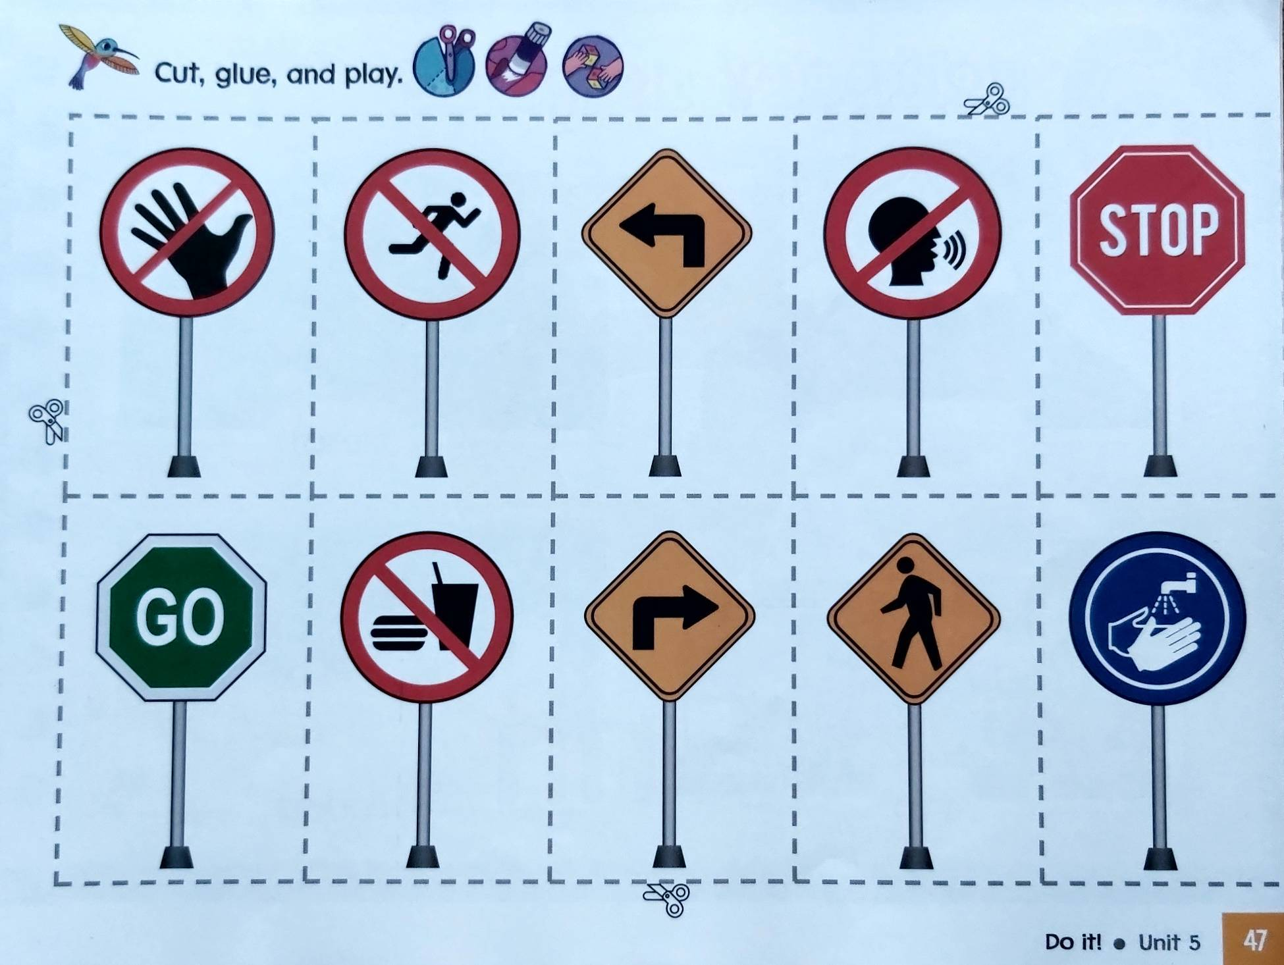
Student’s Book p. 47

Slide 5


Have a nice day🤗
Thank you!

