Slide 1


Trace, draw and say
Departamento de Educación Parvularia
Colegio Madres Dominicas Concepción
Kinder B
Miss Francisca Almarza
May, 2020

Slide 2

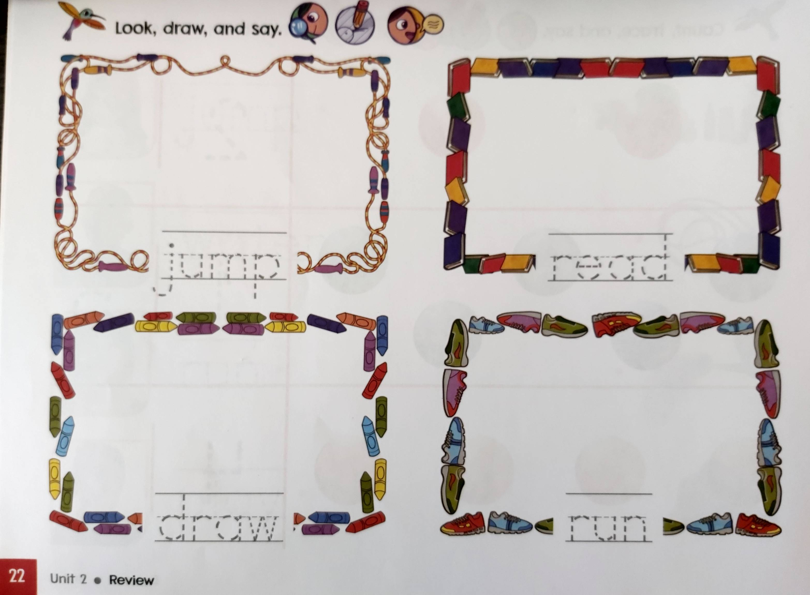
Trace the names

Slide 3
Here says…

Slide 4
Here says…

Slide 5
Here says…

Slide 6
Here says…

Slide 7
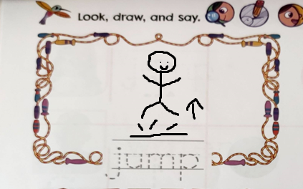
Draw yourself!
Here is an example:

Slide 8


Have a nice day🤗
Thank you!

