Slide 1


Signs around me
Departamento de Educación Parvularia
Colegio Madres Dominicas Concepción
Miss Francisca Almarza
Kinder B
June, 2020

Slide 2

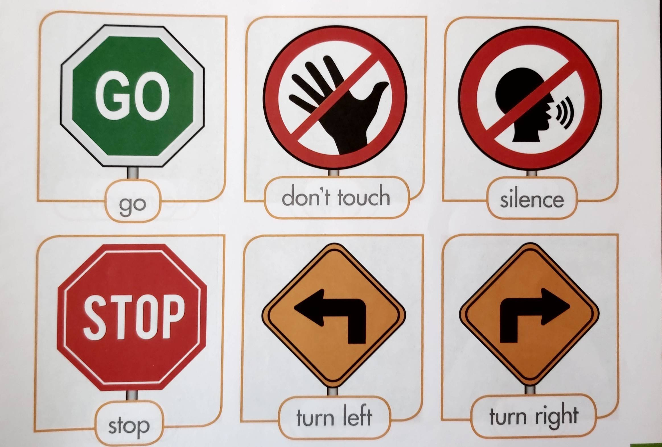
What are “signs”?
They tell you what you can do and can’t do in public spaces. Now, turn to page 77 of your Student’s Book. Do you recognize any of this signs?

Slide 3
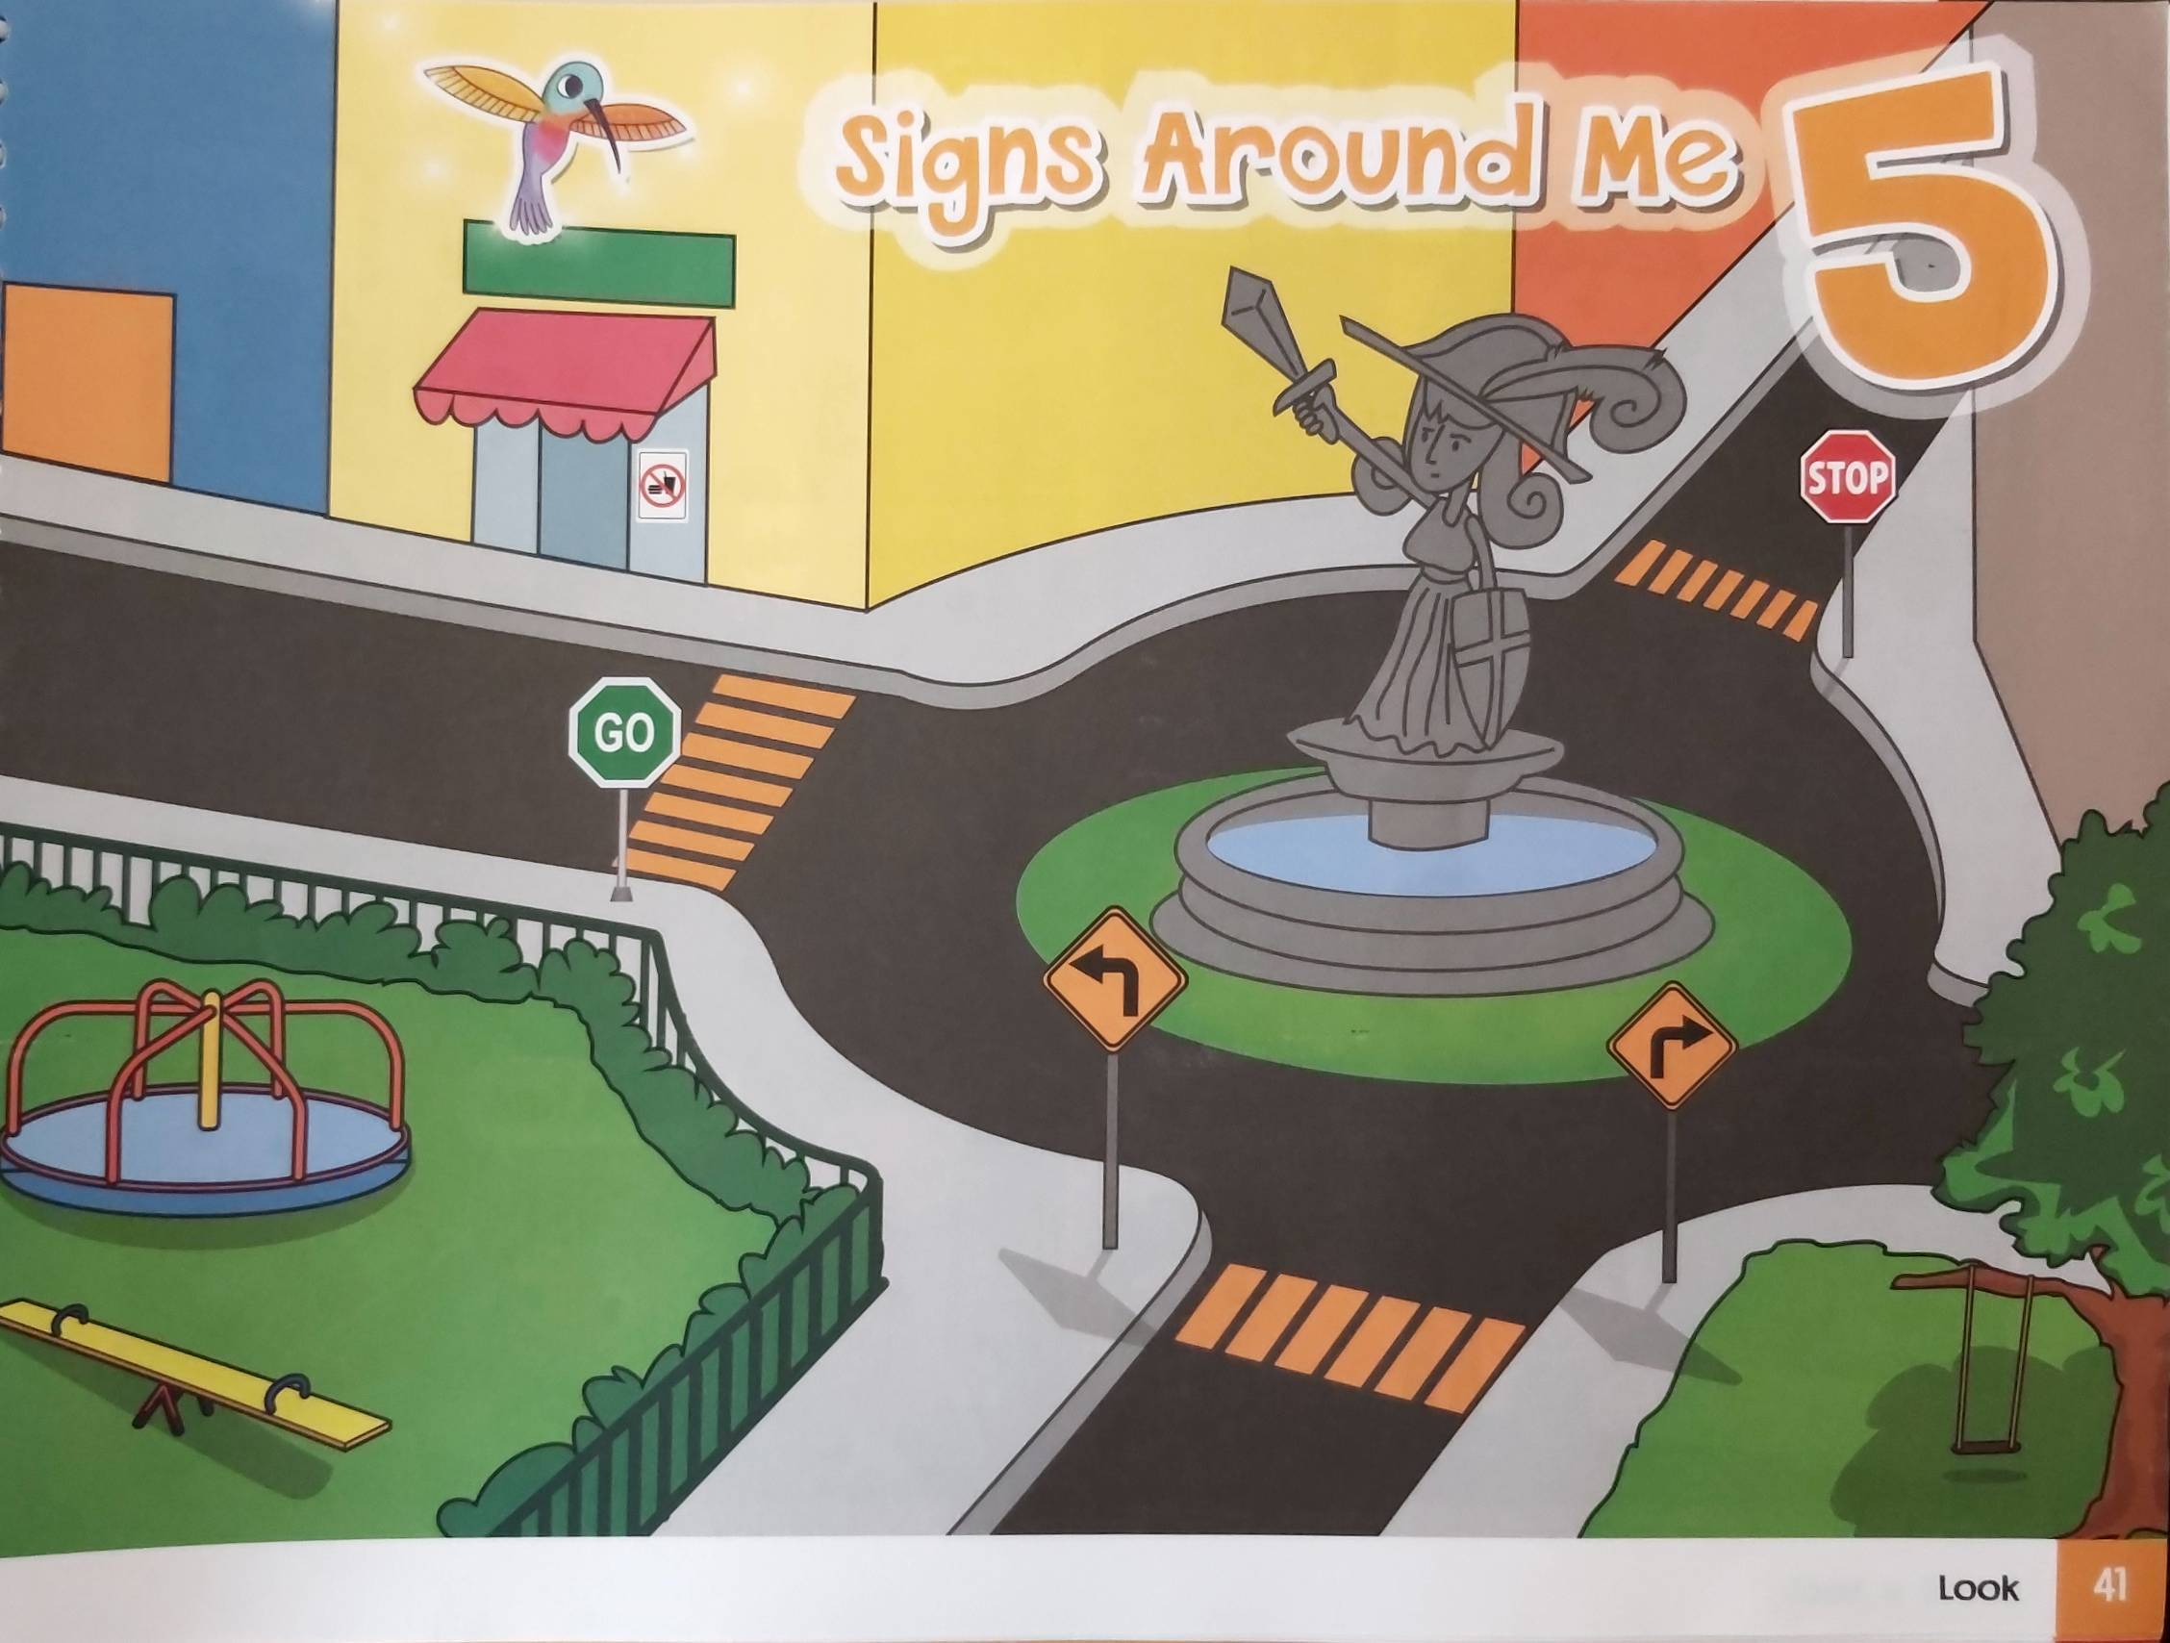
Let’s play a game!
Find and circle all the signs that you see in this image on page 41 of your Student’s Book. For example:

Slide 4

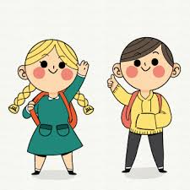
Have a nice day🤗
Thank you!

